Slide 1


PHP Database Handling
Dr. Jenila Livingston L.M.
SCOPE

Slide 2
Database Handling
PHP can connect to
MySQL/MySQLi (i-improved)
MSSQL
Access and other databases like Oracle, Postgre, SQLite etc
There are separate methods available for connecting to the databases

Slide 3
MySQL
MySQL is the most popular open-source database system.
–MySQL is a database server
–MySQL is ideal for both small and large
applications
–MySQL supports standard SQL

Slide 4
MySQL
Databases are useful for storing information category wise.
Data in MySQL is stored in database objects called tables.
A table is a collection of related data entries and it consists of columns and rows.
University db may have: “Department”, “Faculty_info”, “Student_info” “Placement_details”….etc.

Slide 5
University Database
Student Table
RegNo | SName | Mobile
19BCE1001 | Rahul | 9000333333
19BCE1003 | Liana | 9000044444
19BAI1001 | Harleen | 9000044455

Slide 6
Part A: Steps to handle MySQL DB
Start MySQL Server
Go to localhost/phpmyadmin
Create User Account
Create Database
Create Tables
PHP Coding

Slide 7
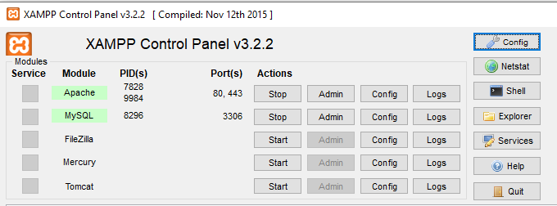
1. Start MySQL server

Slide 8
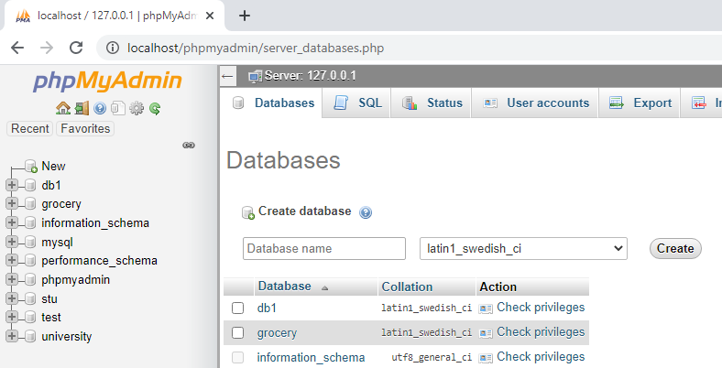
2. localhost/phpmyadmin

Slide 9
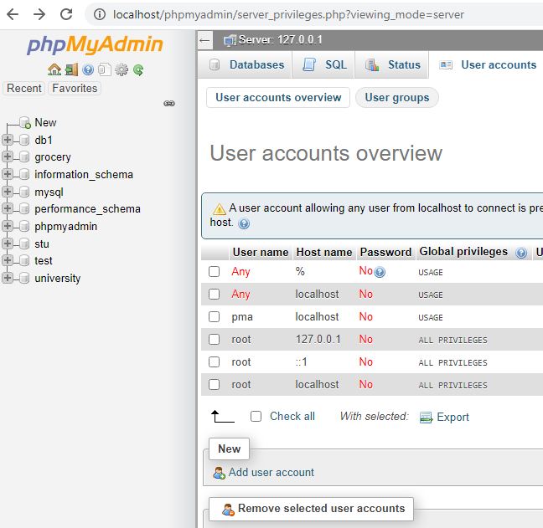
3. Create User Account

Slide 10
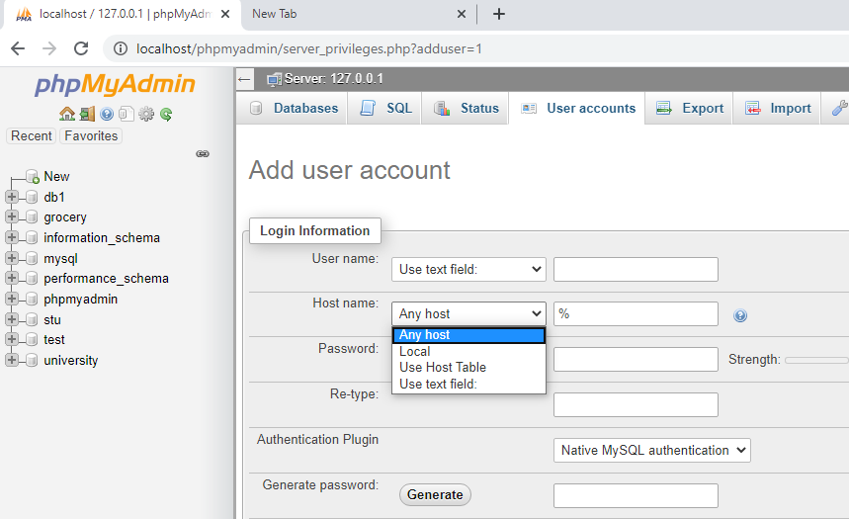
User Account

Slide 11
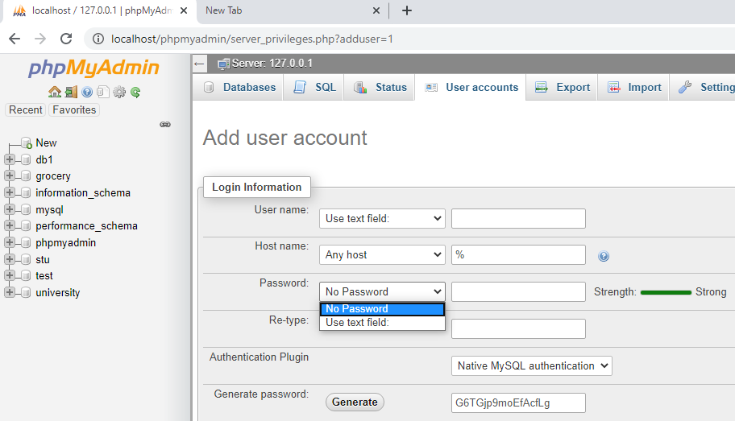
User Account

Slide 12
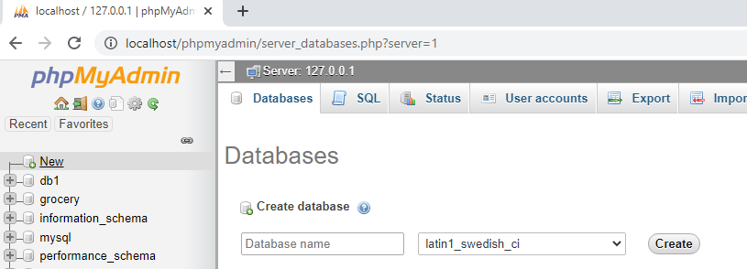
4. Create Database

Slide 13
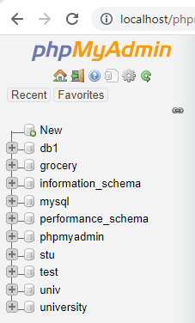
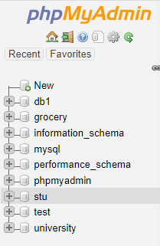
Univ database
- before and after creation

Slide 14
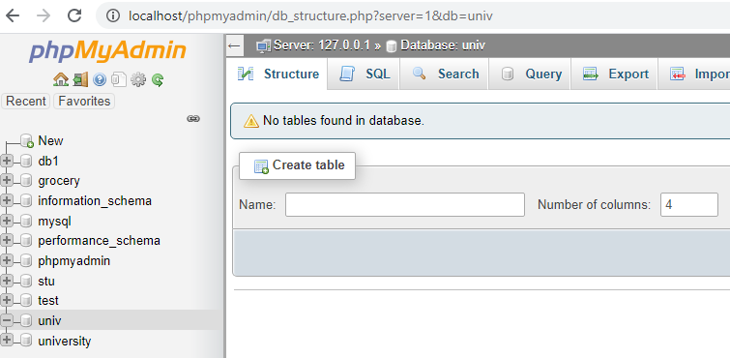
5. Create Table

Slide 15
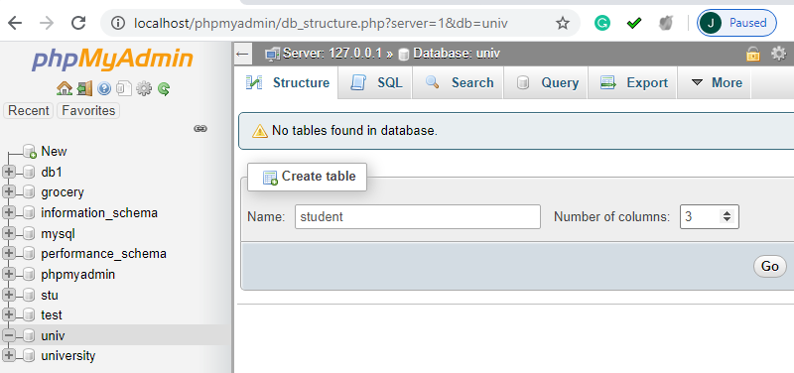
student table

Slide 16
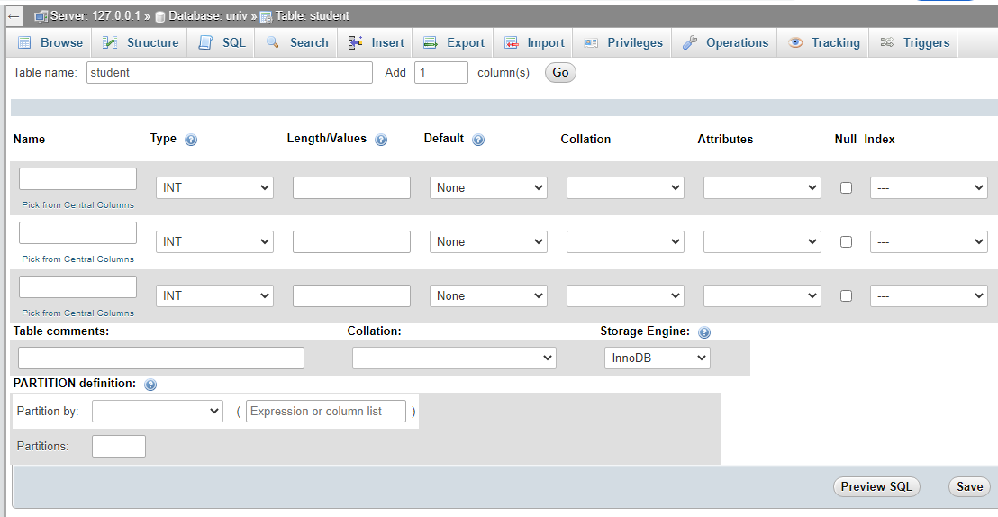
Adding attributes

Slide 17
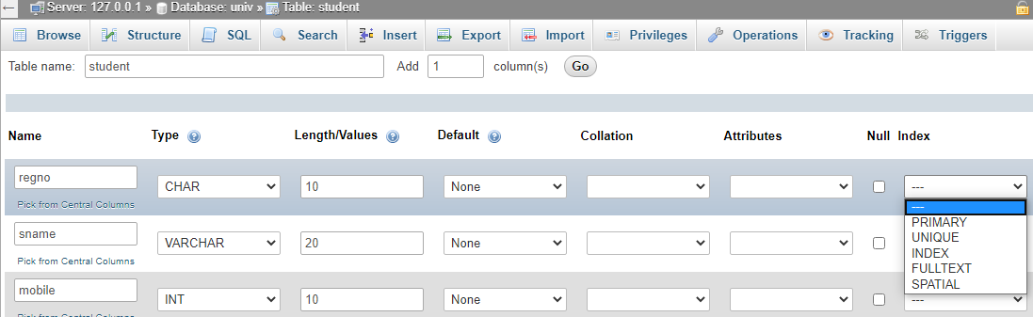
Adding attributes

Slide 18
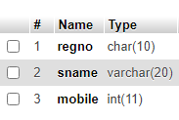
student table schema

Slide 19
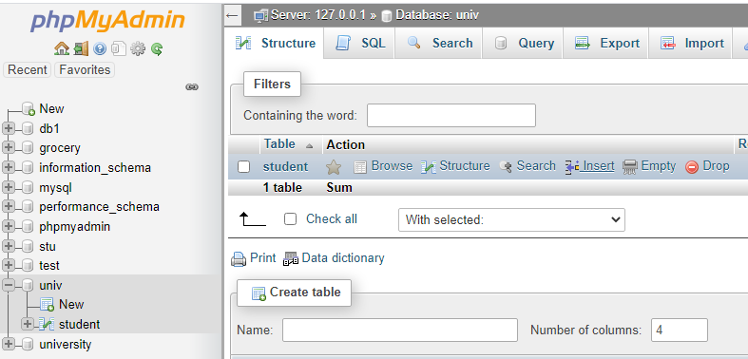
Insert values

Slide 20
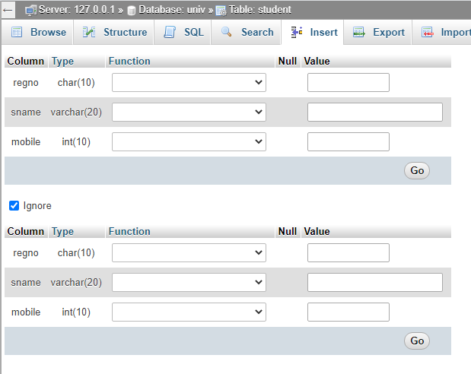
Insert values

Slide 21
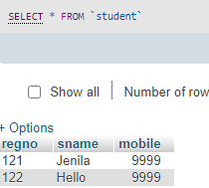
Student table after data Insertion

Slide 22
6. Coding – db.php
<?php
$con = mysqli_connect("localhost","root","");
mysqli_select_db($con,“univ");
$sel='select * from student';
$sq=mysqli_query($con,$sel);
while ($row=mysqli_fetch_array($sq))
{
echo $row['regno']." ".
$row['sname']." ".
$row['mobile'].'<br>';
}
?>

Slide 23
Part B: MySQLi Functions
mysqli_connect()
mysqli_close()
mysqli_select_db()
mysqli_query()
mysqli_fetch_array()
mysqli_num_rows()

Slide 24
1. MySQL dbserver Connection (mysqli_connect)
This method is used for connecting to MySQLi using a userid and password
Syntax:
mysqli_connect(dbserver,userid,password)
Example:
$con = mysqli_connect("localhost","root","root");
This gets a connection to the local mysql server using the credentials root and root
$con = mysqli_connect("localhost","root","");

Slide 25
Parameters
Parameter | Description
servername | Optional. Specifies the server to connect to. Default value is "localhost"
username | Optional. Specifies the username to log in with. Default value is the name of the user that owns the server process
password | Optional. Specifies the password to log in with. Default is ""

Slide 26
Example
We store the connection in a variable ($con) for later use in the script. The "die" part will be executed if the connection fails.
<?php
$con = mysqli_connect("localhost",“jenila",“leni");
if (!$con)
{
die('Could not connect: ' . mysqli_error());
}
?>

Slide 27
Mysql_error()
If server cannot be connected, it will throw an error stating the problem
1049: Unknown database
1046: No database selected

Slide 28
2. MySQLi Close
To close a db connection we have close method
mysqli_close(connection);
Example:
mysqli_close($con);

Slide 29
3. Connect Database (mysqli_select_db)
Syntax: mysqli_select_db(connection,dbname)
mysqli_select_db($con,”univ”);
This will select the univ db under the server localhost

Slide 30
4. Working with Queries
To get PHP to execute the SQL statements we must use the mysql_query() function. This function is used to send a query or command to a MySQL connection.
Syntax:
mysqli_query($con,”sqlquery”);
or
$sql=“Any SQL Query”;
mysqli_query($con,$sql);

Slide 31
Grocery Database
Product Table
Productcode | ProductName | Cost | Manufacturer
P001 | Cheese | 150 | Creamcenter
P002 | Salt | 15 | Tata
P003 | Butter | 40 | XYZ

Slide 32
4.1 Create database
The CREATE DATABASE statement is used to create a database in MySQL.
Syntax:
$sql=CREATE DATABASE database_name;
$result=mysqli_query($con,$sql)

Slide 33
Create a Database
Example :The following example creates a database called "grocery"
$sql="CREATE database grocery";
$result=mysqli_query($con,$sql) or die(mysqli_error());
if ($result)
echo "database created successfully";

Slide 34
4.2 Create a Table
The CREATE TABLE statement is used create a table in MySQL.
Syntax:
CREATE TABLE table_name ( column_name1 data_type, column_name2 data_type, column_name3 data_type, .... )
We must add the CREATE TABLE to the statement mysql_query() function to execute the command.

Slide 35
Create a Table
Example:
$sql="create table product(productcode char(7), productname varchar(20),cost int, Manufacturer varchar2(15))";
mysqli_query($con,$sql);

Slide 36
4.3 Insert Data into a Table
The INSERT INTO statement is used to add new records to a database table.
Syntax:
INSERT INTO statement is in two forms.
The first form doesn't specify the column names where the data will be inserted, only their values:
INSERT INTO table_name VALUES (value1, value2, ...)
The second form specifies both the column names and the values to be inserted:
INSERT INTO table_name (column1, column2, ...)
VALUES (value1, value2, ...)

Slide 37
Insert Data into a Table
Example:
sql= "insert into product
(productcode,productname,cost)
values (‘P001','Cheese',150)";
mysqli_query($con,$sql)

Slide 38
Insert Data from a Form
Create an HTML form that can be used to add new records to the “product" table.
<html> <body>
<form action="fromform.php" method="post">
Product Code: <input type="text" name="pcode">
Product Name: <input type="text" name="pname">
Cost: <input type="text" name="cost">
<input type="submit">
</form> </body>
</html>

Slide 39
Insert values from a form
$sql="insert into product (productcode,productname,cost)
values('$_POST[pcode]',
'$_POST[pname]',
'$_POST[cost]')”;
mysqli_query ($con,$sql);
echo "No. of records added: 1";

Slide 40
4.4 Update data in a Table
The UPDATE statement is used to update existing records in a table.
Syntax:
UPDATE table_name
SET column1=value, column2=value2,...
WHERE some_column=some_value
Example:
mysqli_query($con,"update product set
cost=300 where productcode=‘P001'");

Slide 41
4.5 Delete data from a table
The DELETE FROM statement is used to delete records from a database table.
Syntax:
DELETE FROM table_name WHERE column_name = value
Example:
mysqli_query($con,"delete from product
where productcode=‘P002'");

Slide 42
4.6 Select Data from a Table
The SELECT statement is used to select data from a table.
Syntax:
SELECT column_name(s) FROM table_name;
SELECT column_name(s) FROM table_name where condition;

Slide 43
5. Select Data from a Table (mysqli_fetch_array)
$rs=mysqli_query($con,select stmt);
The rows of select statement will be stored in $rs
$row = mysqli_fetch_array($rs);
This will fetch a row and store in $row
Values can be accessed like - $row[“ID”] – returns value of column ID in the fetched row.

Slide 44
Using Associative array
$result=mysqli_query($con,"select * from product where productcode=‘P001’");
while ($row=mysqli_fetch_array($result))
{
echo $row['productcode']." ".
$row['productname']." ".
$row['cost'].'<br>';
}

Slide 45
Using Numerical array
$result=mysqli_query($con,"select * from products where prodcode='CHE'");
while ($row=mysqli_fetch_array($result))
{
echo $row[0]. "".$row[1]."".$row[2].'<br>';
}

Slide 46
Using orderby
$result=mysqli_query("select * from product
order by cost desc");
while ($row=mysqli_fetch_array($result))
{
echo $row['productcode']."".
$row['prodname']." ".
$row['cost'].'<br>';
}

Slide 47
DB program
<?php
$con = mysqli_connect("localhost","root","");
mysqli_select_db($con,“univ");
$sel='select * from student';
$sq=mysqli_query($con,$sel);
while ($row=mysqli_fetch_array($sq))
{
echo $row['regno']." ".
$row['sname']." ".
$row['mobile'].'<br>';
}
?>

Slide 48
6. mysqli_num_rows
Return the number of rows in a result set:
Syntax:
$rowcount=mysqli_num_rows($result);

Slide 49
Functions Covered
mysqli_connect()
mysqli_select_db()
mysqli_close()
mysqli_query()
mysqli_fetch_array()
mysqli_num_rows()

Slide 50
Part C: Write the table data into a file
Write the table data into a file
Write the file data into a table

Slide 51
To write the table data into a file – dbdisplayoutput.php
$result=mysqli_query($con,"select * from products into outfile 'D:/products.txt'");

Slide 52
To write the data file data into table - dbdisplaywrite.php
$result=mysqli_query($con,"load data local infile
'D:\products.txt' into table abc");
$result=mysqli_query($con,"load data local infile 'D:\products.txt' into table abc(productname,productcode,cost)”;

Slide 53


